Slide 1
DESKTOP VIRTUAL ASSISTANT
Submitted by: Guide: Ms. Anshula GUPTA
Suraj Gupta
Sushant Pandey
Srijan shahi

Slide 2
INTRODUCTION
In this project, the user is just expected to give voice commands, and the rest work is done by our voice assistants which can automate the complete process and completes our task. As Virtual Assistants perform tasks as a human can. It can send emails, play music, and talk to you accordingly.
Viber voice chat API can shift between conversations, block/unblock conversations, Turn On/Off notifications, and much more. To build this functionality, We will use different libraries and modules like Tkinter, Web browser, Datetime, Requests, pyPDF2, pyautogui, pyQt, and BeautifulSoup.

Slide 3
PROBLEM STATEMENT
Understanding user voice commands.
Can't read, or send SMS/Emails.
Security Issues
Not able to read Notifications
No desktop app is available
Eavesdropping Aspect (Off automatically when there are no commands from the user end)

Slide 4
OBJECTIVE
Existing Virtual Assistants have some limitations like can’t read messages, and can’t access other web applications. To overcome these limitations, we will integrate various APIs to eradicate those limitations which will save time, and enhance productivity.

Slide 5
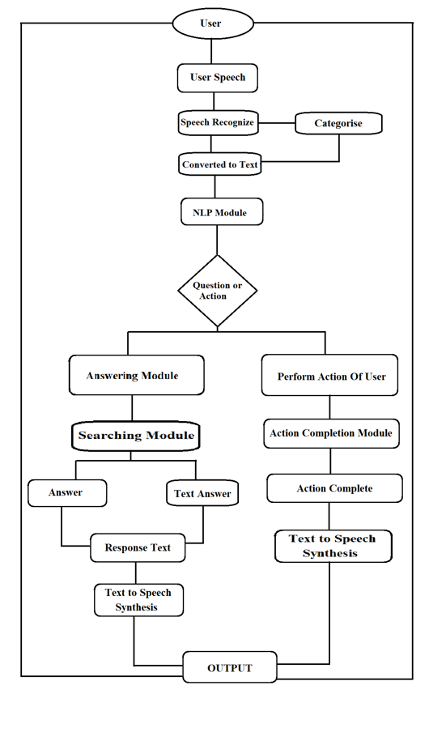
Workflow of Voice Assistant

Slide 6
TOOLS/LIBRARIES
pyttsx3: It is a python library that converts text to speech.
Speech Recognition: It is a python module that converts speech to text.
pywhatkit: It is a python library to send WhatsApp messages at a particular time with some additional features.
Wikipedia: It is a python module for searching anything on Wikipedia.
smtplib: Simple mail transfer protocol that allows us to send emails and route mail between mail servers.

Slide 7
PyPDF2: It is a python module that can read, split, and merge any PDF.
Web browser: It provides an interface for displaying web-based documents to users.
Pyautogui: It is a python library for the graphical user interface.
os: It represents Operating System-related functionality.

Slide 8
TECHNOLOGIES
NLP: The ability to understand the text and spoken words in much the same way human beings can.
NLU: Refers to the ability of a computer to use syntactic and semantic analysis to determine the meaning of text or speech.
NLG: Enables computing devices to generate text and speech from data input.

Slide 9
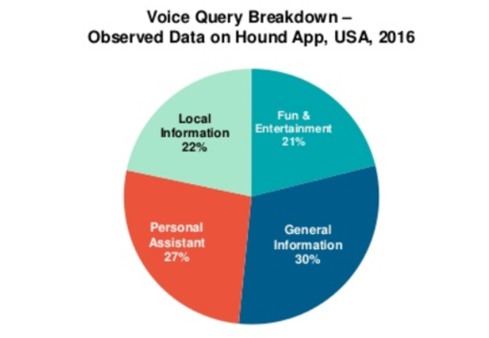
Fact

Slide 10
CONCLUSION
A voice assistant, without any doubt, as it saves time for the user through conversational interactions, effectiveness, and efficiency. But while working on this project, there were some limitations encountered, and also realized some scope for enhancement in the future.

Slide 11
THANK YOU!!

